Slide 1

Marketing & Retail Analytics Project Milestone -2
Athisya Nadar
Post Graduate Program in Data Science and Business Analytics
athisya@gmail.com

Slide 2
AGENDA
Problem statement
Executive summary
Exploratory Data Analysis
Market Basket Analysis (Association Rules)
Associations Identified
Suggestion of Possible Combos with Lucrative Offers

Slide 3
Problem Statement
A Grocery Store shared the transactional data with you. Your job is to identify the most popular combos that can be suggested to the Grocery Store chain after a thorough analysis of the most commonly occurring sets of items in the customer orders. The Store doesn’t have any combo offers. Can you suggest the best combos & offers?
Notes:
May require more than one slide

Slide 4
Executive summary
We have got data for grocery store with date, order ID and Products. This project involves conducting a thorough analysis of Point of Sale (POS) Data for providing recommendations through which a grocery store can increase its revenue by popular combo offers & discounts for customers.
We have used python for EDA and KNIME for Market Basket Analysis (Association Rules) and calculated support, confidence, & lift values.

Slide 5
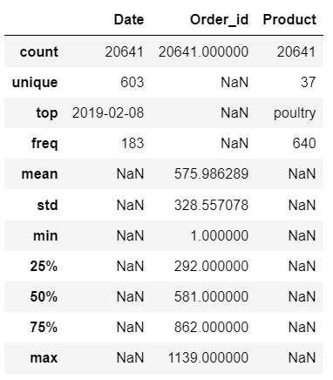
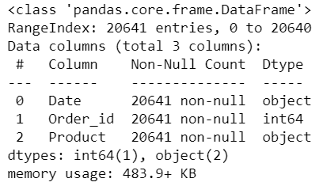
Exploratory Data Analysis
The data consists of 20641 records and 3 columns
There are 4730 duplicate records which we have dropped before analysis
There are no null values

Slide 6
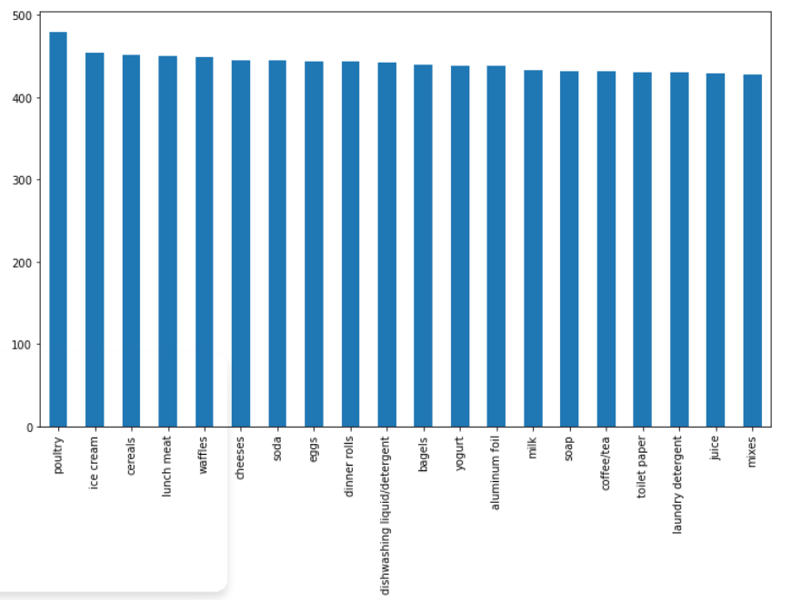
Product

Slide 7
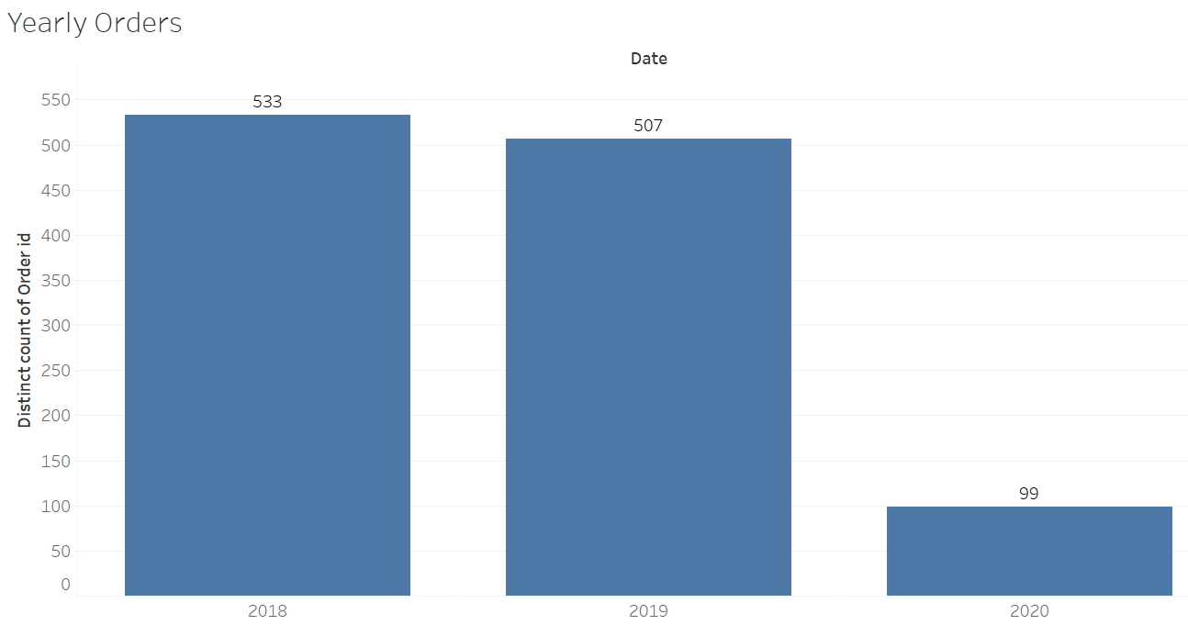
Yearly Orders

Slide 8
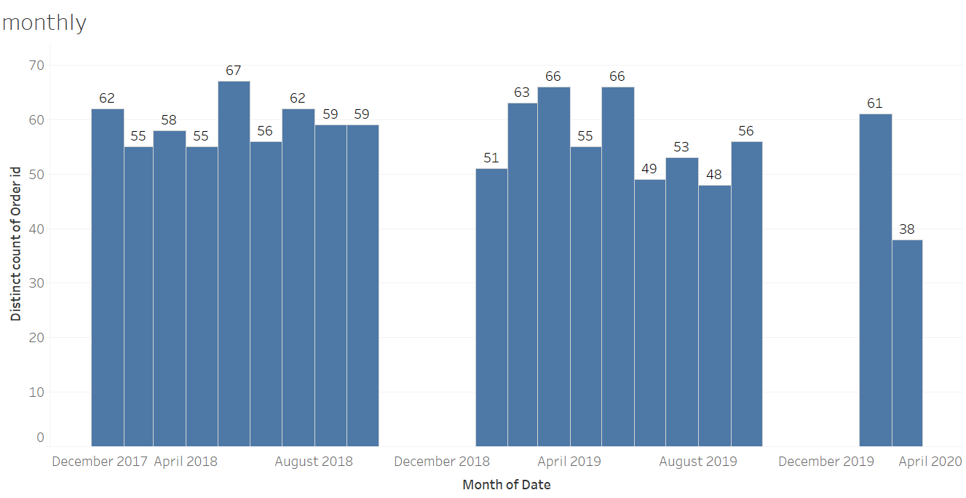
Monthly Orders

Slide 9
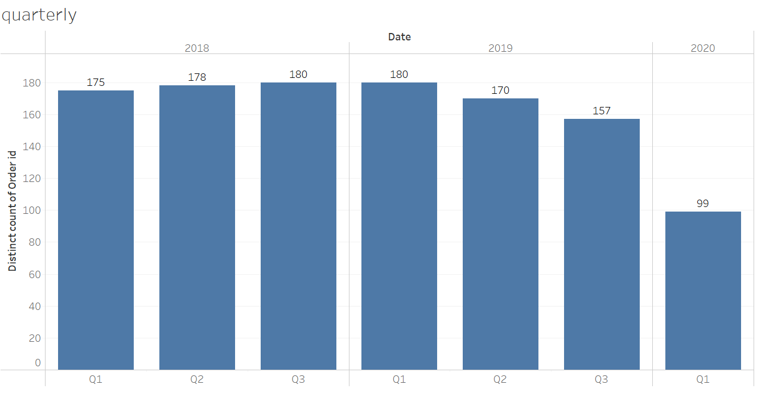
Quarterly Orders

Slide 10
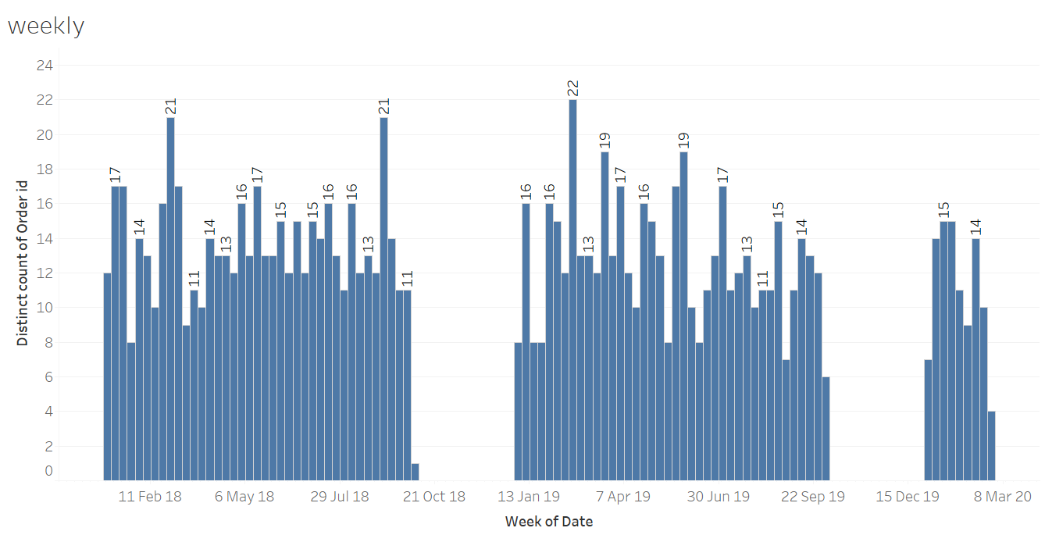
Weekly Orders

Slide 11
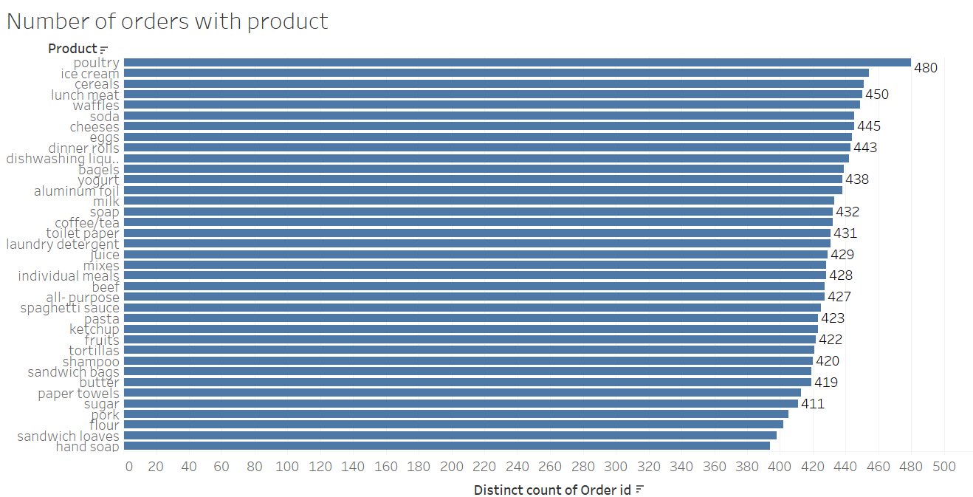
Orders for each product

Slide 12
Exploratory data analysis inferences:
Most orders are from 2018 followed by 2019 then 2020
Quarterly data shows highest number of orders for 2018(Q3) and 2019(Q1)
Monthly data shows highest order for may 2018
Poultry, ice cream, cereals, lunch meat, waffles show up in the top 5 most number of orders
Poultry, soda, cereals, ice cream, cheeses are top 5 most number of products ordered

Slide 13
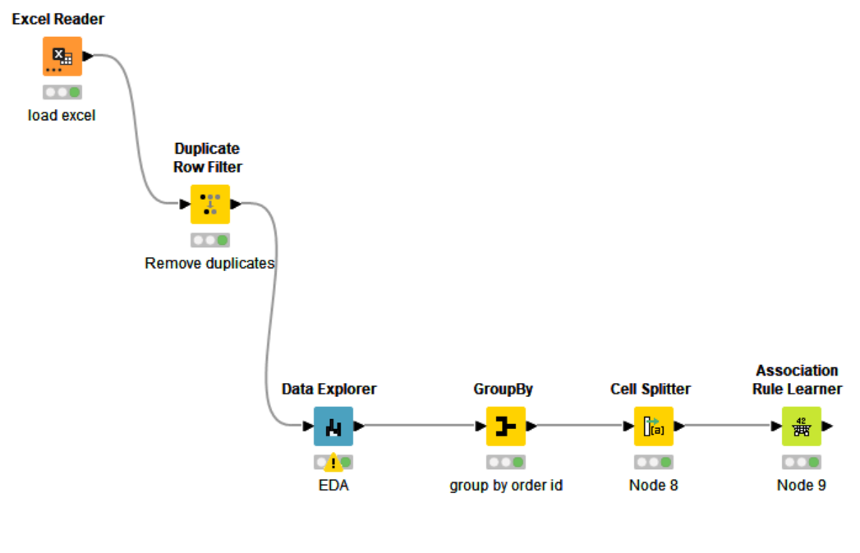
KNIME work flow

Slide 14
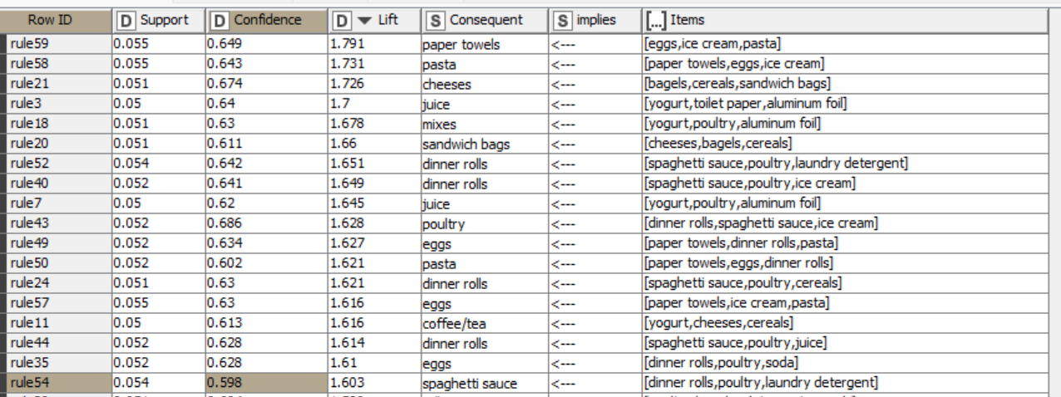
Associations Identified
Notes:
May require more than one slide

Slide 15
Support
The percentage of transactions that contain all of the items in an itemset (e.g., poultry and dinner rolls). The higher the support the more frequently the itemset occurs. Rules with a high support are preferred since they are likely to be applicable to a large number of future transactions. We have set minimum support threshold at 0.05
After calculating support we can see that
poultry and dinner rolls show highest support of 0.195
Dinner rolls and spaghetti sauce, poultry show support of 0.099
Juice and poultry, aluminum foil shows support of 0.096
Eggs and dinner rolls, soda show support of 0.095
Notes:
May require more than one slide

Slide 16
Confidence
The probability that a transaction that contains the items on the left hand side of the rule (in our example, dinner rolls, spaghetti sauce, ice cream ) also contains the item on the right hand side (poultry). The higher the confidence, the greater the likelihood that the item on the right hand side will be purchased or, in other words, the greater the return rate you can expect for a given rule. Typically, association rules are considered interesting if they satisfy both a minimum support threshold and a minimum confidence threshold. We have set minimum confidence threshold at 0.5
After calculating confidence we can see that:
Poultry and dinner rolls, spaghetti sauce , ice cream show confidence of 0.686
Cheeses and bagels, cereals, sandwich bags show confidence of 0.674
Poultry and dinner rolls, spaghetti sauce, laundry detergent show confidence of 0.656

Slide 17
Lift
Lift summarises the strength of association between the products on the left and right hand side of the rule; the larger the lift the greater the link between the two products. In other words, the probability of all of the items in a rule occurring together. If Lift is greater than 1, it means that the target response is more likely than the average response.If Lift is below 1, the target response is less likely than the average response. As a result, the association rule lessens the chances of the desired outcome. A lift of 1 means that the model (or association rule) does not affect the outcome.
After calculating lift we get following results:
Paper towels and eggs, ice cream, pasta show lift of 1.791
Pasta and paper towels, eggs, ice cream show lift of 1.731
Cheeses and bagels, cereals, sandwich show lift of 1.726
Juice and yogurt, toilet paper, aluminium foil show lift of 1.7

Slide 18
Recommendations:
Support ranges from 0.195 to 0.05 ….19.5% support would mean that 19.5 out of 100 sales include the poultry and dinner rolls.
Confidence ranges from 0.686 to 0.5…68.6% confidence means 6.86 out of 10 sales transaction with poultry, dinner rolls, spaghetti sauce, ice cream. In other words if you buy dinner rolls, spaghetti sauce, ice cream there is 68.6% chance that you would buy poultry
Lift ranges from 1.791 to 1.186 ……for all the rules the lift is above 1. more the lift more the chances of customer buying paper towels with eggs,ice-cream,pasta

Slide 19
Combo Offers:
Combo 1
Ice cream +
Paper towels
Combo 2
Cheese
+
Sandwich
10% discount
Combo 3
Pasta
+
eggs
Combo 4
10% discount
10% discount
Toilet paper
+
Aluminum foil
Buy 2 get 1 free
Combo 5
Juice
+
Yogurt
20%
discount
Combo 6
Cereals
+
cheese
5%
discount

Slide 20
Thank You

